Slide 1
Fandango Movie Rating Discrepancy Analysis
CAPSTONE PROJECT
Presented By
SELVAPRIYA P– Anna University Regional Campus Madurai
- B.E CIVIL Engineering

Slide 2
OUTLINE
Problem Statement
Proposed System/Solution
System Development Approach
Algorithm & Deployment
Result
Conclusion
Future Scope
References

Slide 3
Problem Statement
The Fandango Movie Rating Discrepancy Analysis project addresses concerns regarding the accuracy and transparency of movie ratings on the Fandango platform.
Recent investigations have revealed significant disparities between Fandango ratings and those of other movie rating platforms like Rotten Tomatoes or IMDb, raising questions about the reliability of Fandango's rating system.
This project seeks to investigate the extent of rating inflation on Fandango, understand the factors contributing to this inflation, and propose solutions to ensure fair and accurate movie ratings for consumers.

Slide 4
Proposed Solution
The proposed solution involves implementing algorithms to analyze and compare movie ratings across different platforms, with a focus on Fandango.
Transparency measures will be developed to enhance the visibility of rating calculation methodologies and incorporate user feedback mechanisms.
Additionally, accuracy enhancement strategies such as algorithm adjustments and data validation processes will be implemented to mitigate rating inflation and improve the reliability of Fandango's rating system.

Slide 5
System Approach
System Requirements:
Hardware:
Standard PC or laptop with sufficient processing power and storage capacity.
Software:
Python programming language (version 3.x), Jupyter Notebook for code development and documentation.
Library Requirements:
Data Processing & Analysis:
Pandas for data manipulation, NumPy for numerical operations, scikit-learn for machine learning algorithms.
Data Visualization:
Matplotlib and Seaborn for static visualizations, Plotly or Bokeh for interactive visualizations.

Slide 6
Algorithm & Deployment
Data Manipulation Algorithms:
Selection: Selecting specific rows or columns from the DataFrame based on certain criteria (e.g., filtering movies with zero votes).
Sorting: Sorting DataFrame entries based on a particular column (e.g., finding movies with the highest number of votes).
Transformation: Creating new columns derived from existing ones (e.g., extracting year from film titles).

Slide 7
Algorithm & Deployment
Data Visualization Algorithms:
Scatter Plots: Visualizing the relationship between two numerical variables (e.g., movie rating vs. number of votes).
Distribution Plots (KDE and Histograms): Representing the distribution of a single variable (e.g., distribution of movie ratings or the difference between displayed stars and true ratings).
Count Plots: Visualizing the frequency of categorical data (e.g., number of movies per year).
These visualizations are likely created using Matplotlib and Seaborn functions.

Slide 8
Algorithm & Deployment
Statistical Algorithms (descriptive statistics):
Mean and standard deviation: While not explicitly calculated in the provided code, these are likely used to summarize numerical data (e.g., average movie rating or average vote count).
Minimum and Maximum: These might be used to find movies with the lowest or highest ratings.
These calculations are likely performed using Pandas functions.

Slide 9
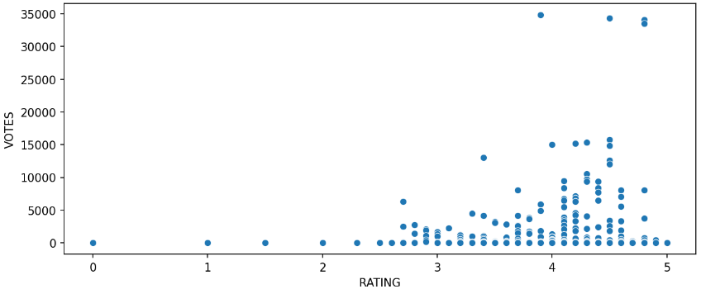
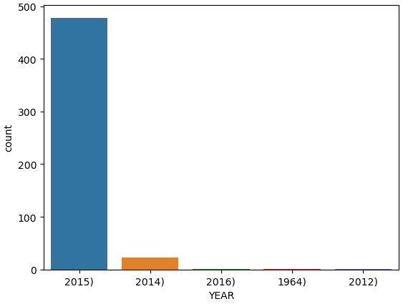
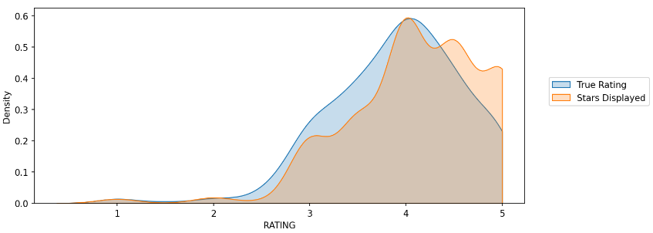
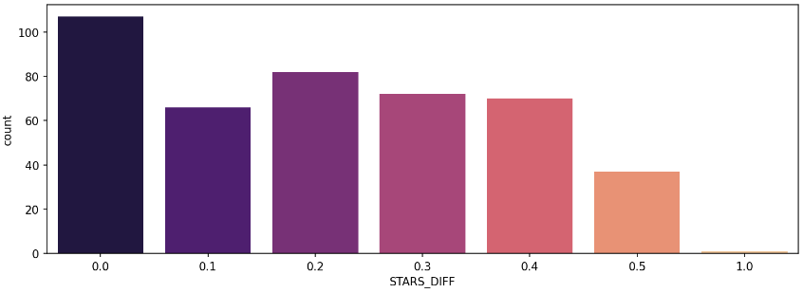
Result

Slide 10
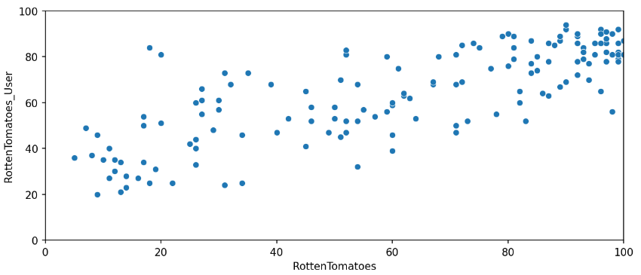
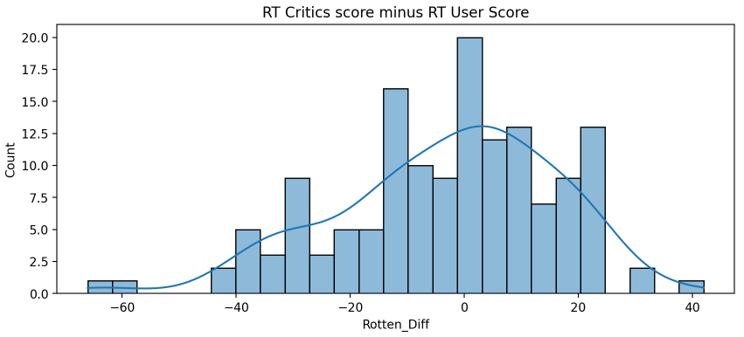
Result

Slide 11
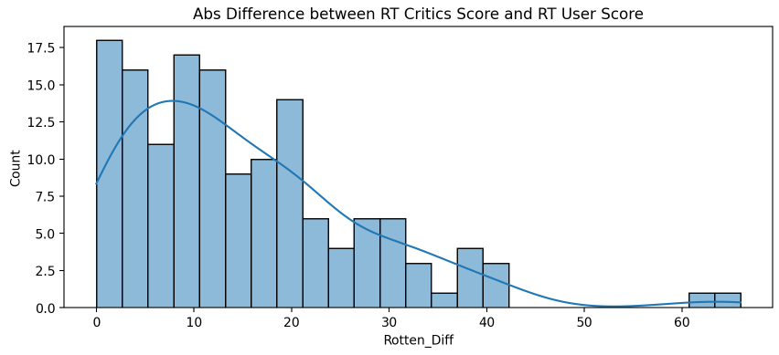
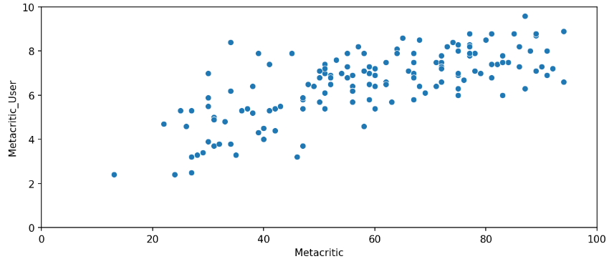
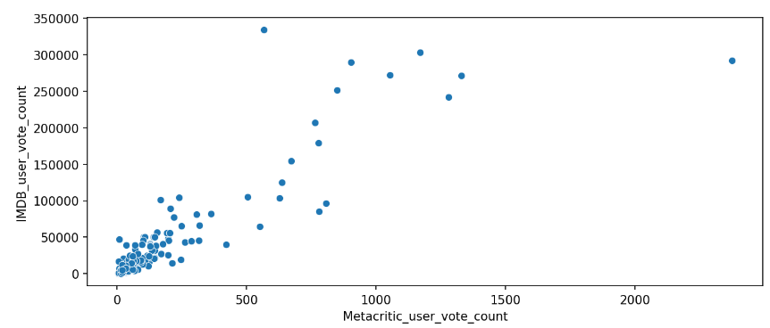
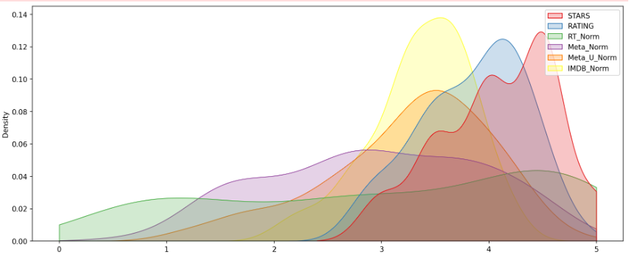
Result

Slide 12
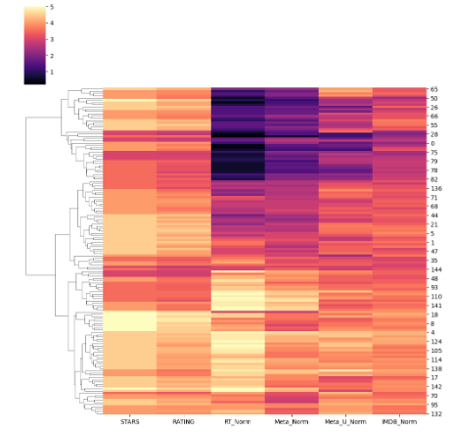
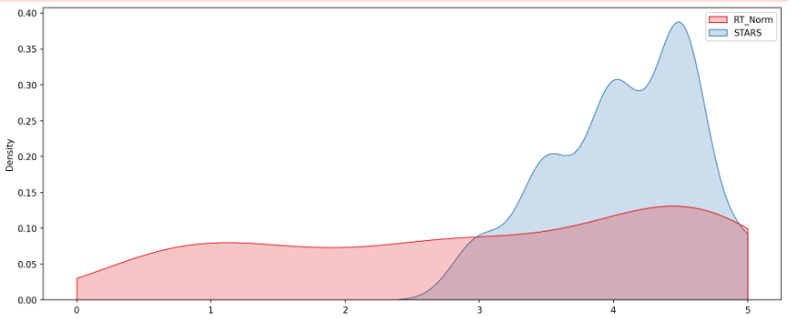
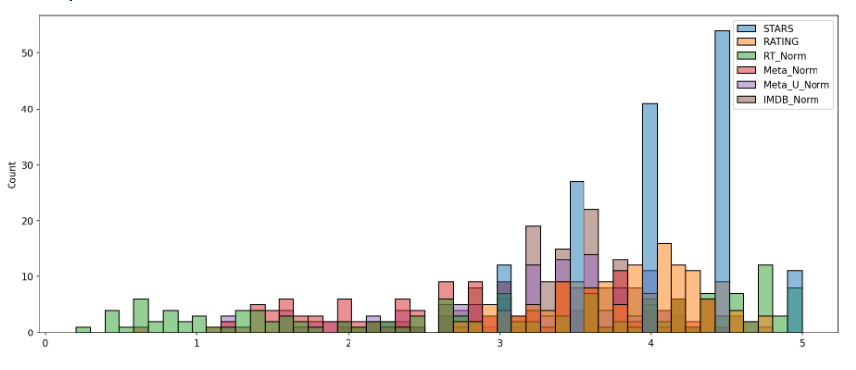
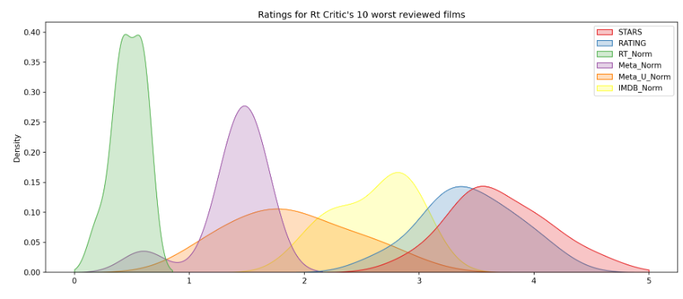
Result

Slide 13
Conclusion
In conclusion, the Fandango Movie Rating Discrepancy Analysis project sheds light on the challenges faced by Fandango in maintaining accurate and transparent movie ratings.
The findings underscore the importance of addressing rating inflation to ensure consumer trust and industry integrity.
While the proposed solutions show promise in mitigating rating disparities, ongoing monitoring and adaptation will be essential to maintain the effectiveness of the rating system.

Slide 14
Future scope
Explore real-time prediction capabilities to provide up-to-date movie ratings to users.
Implement personalization and customization features to tailor movie recommendations based on individual preferences and viewing history.
Investigate the integration of machine learning models for dynamic rating adjustments based on user feedback and evolving trends in the movie industry.

Slide 15
References
https://www.kaggle.com/datasets
https://pandas.pydata.org/pandas-docs/stable/user_guide/index.html
https://seaborn.pydata.org/
https://matplotlib.org/stable/contents.html

Slide 16
THANK YOU

